Slide 1

Group11
Hongkai Huang
Chengkai Yang
CMPE 131 Final Presentation
Spring 2021
Dr. Hungwen Li

Slide 2
TiaoTiaoXiong TV

Slide 3
Proposal

Slide 4

Competitor Analysis

Slide 5





Slide 6


Free
Screening
Room
Immersive Experience
Custom Medias
MyCircle TV Zoom Netflix

Slide 7

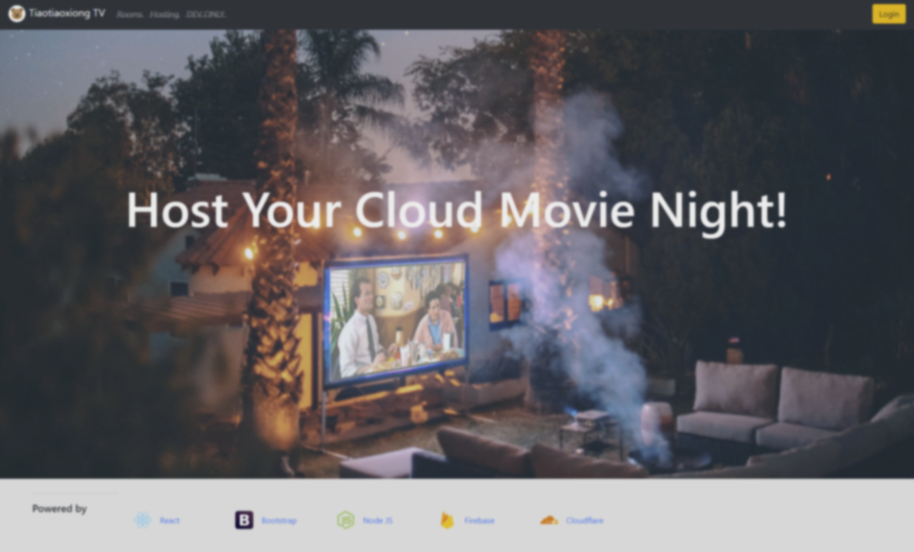


Slide 8
Plan

Slide 9

Design

Slide 10
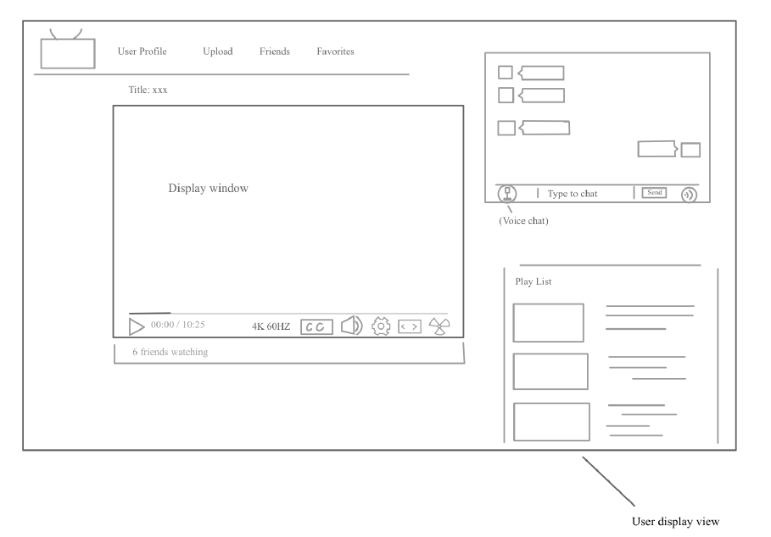

Slide 11
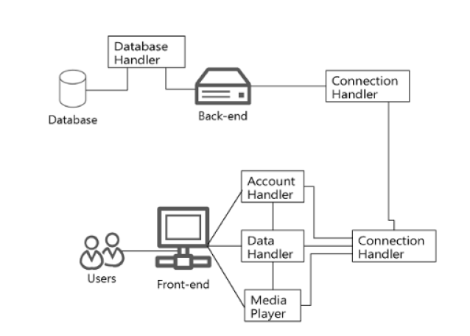
Front-end
Contains two pages, which is the login page and media room page.
Pages use JavaScript to send requestsand listen to responses. And the
media player components load the media file from the path contained in
the response
Back-end
Uses JavaScript framework to parse requests from front-end and query
from database to authentic users orsend back a media list.

Slide 12

User Requirement
1.TiaoTiaoXiong TV web application shall be able to receive videos/movies uploaded by users and share/stream them to all users who have access to their online media room simultaneously.
2.Users shall be able to chat or text during movie displaying/sharing time for interpersonal communication among friends and family.
3.Users shall be able to store these videos/movies for future watching

Slide 13

Schedule

Slide 14
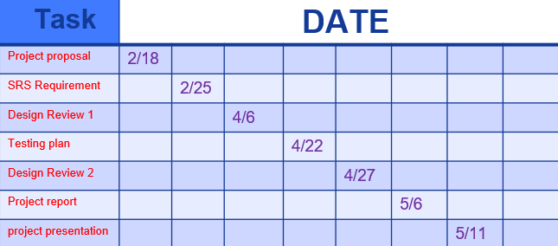

Slide 15

Iterations

Slide 16
Design Review 1

Slide 17
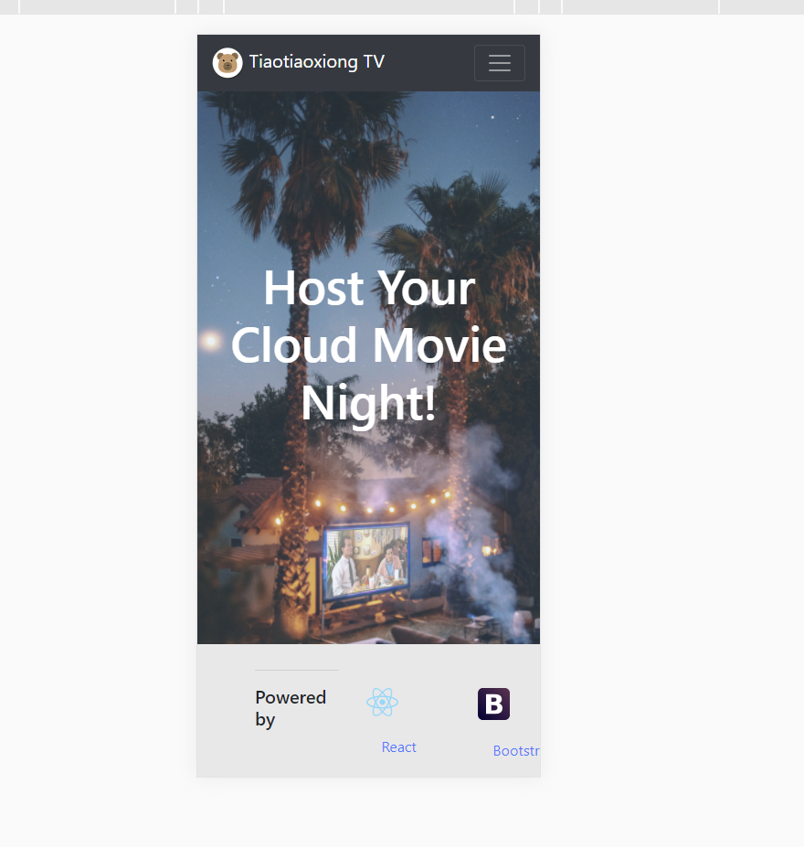
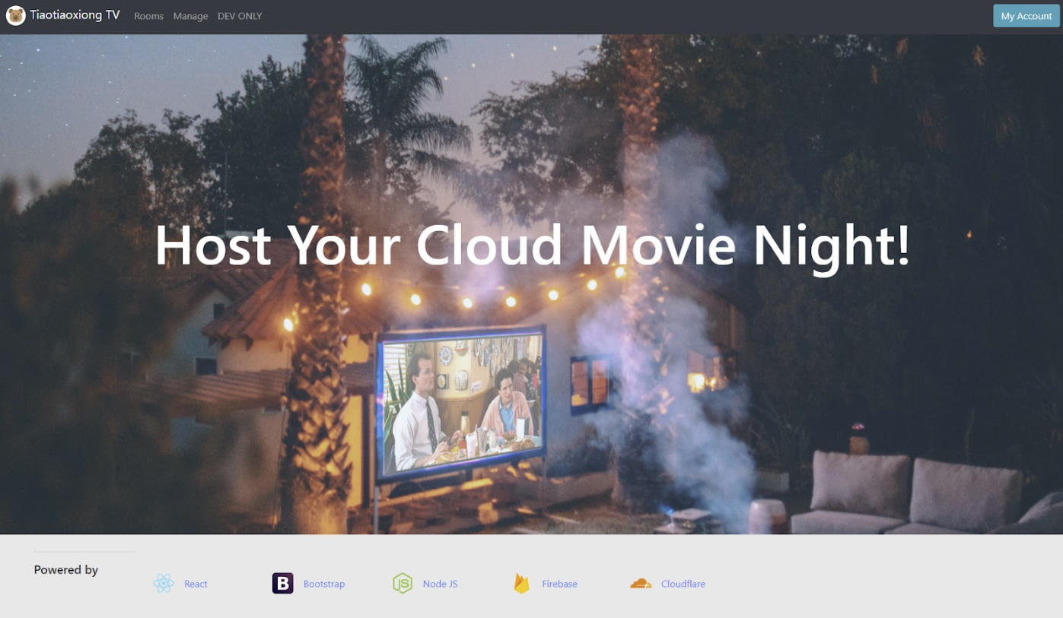
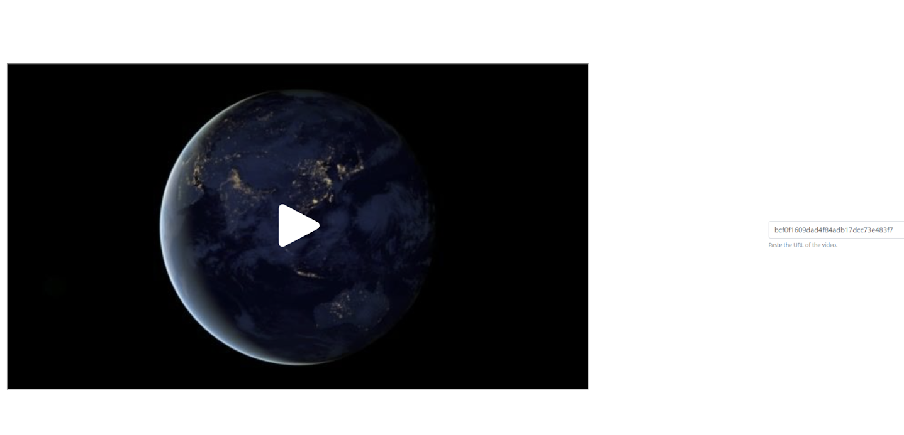

Slide 18
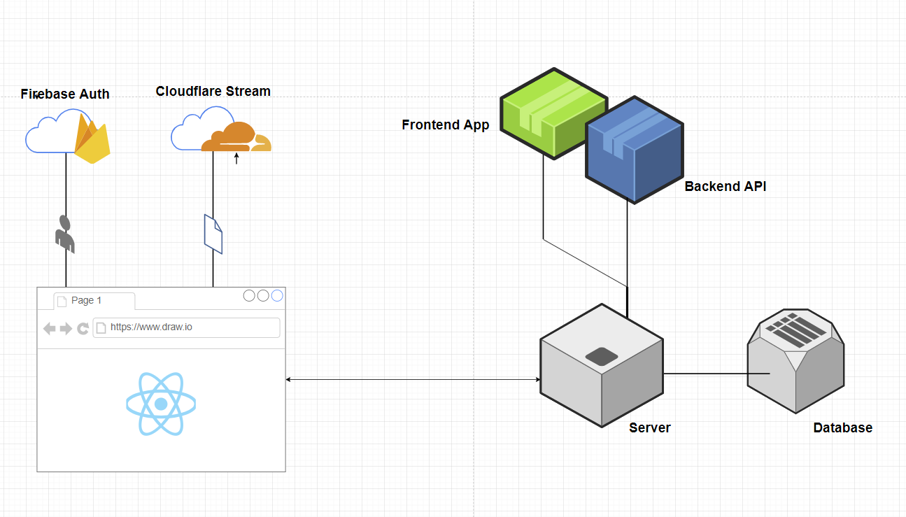
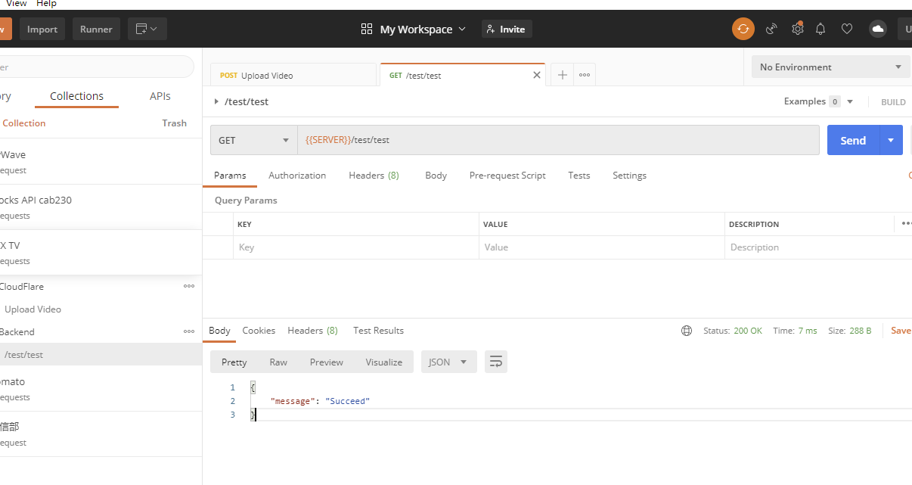
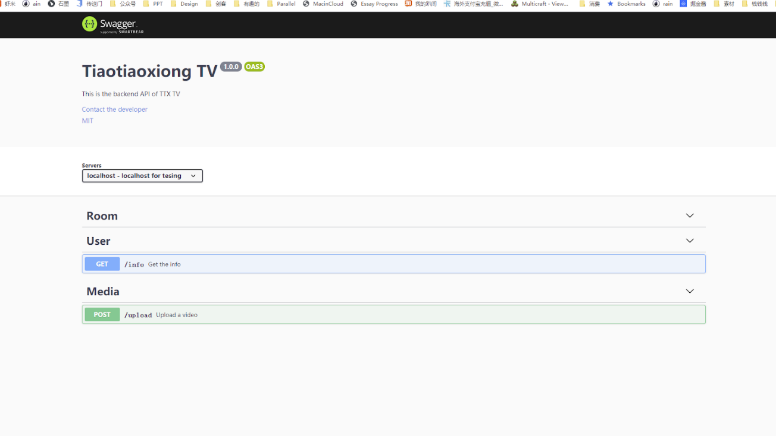

Slide 19
Design Review 2

Slide 20
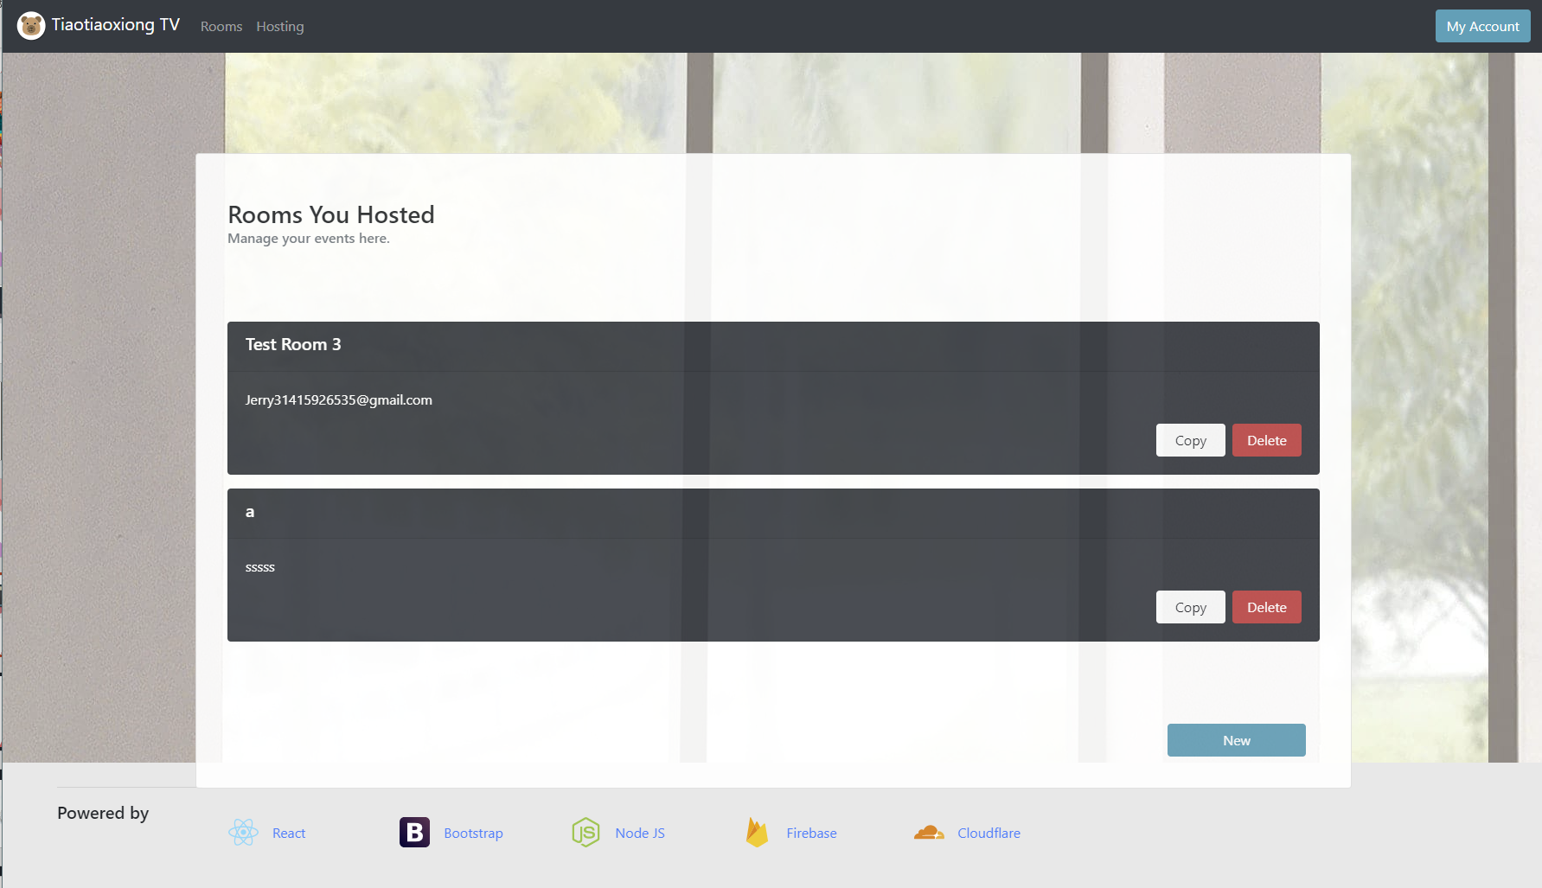
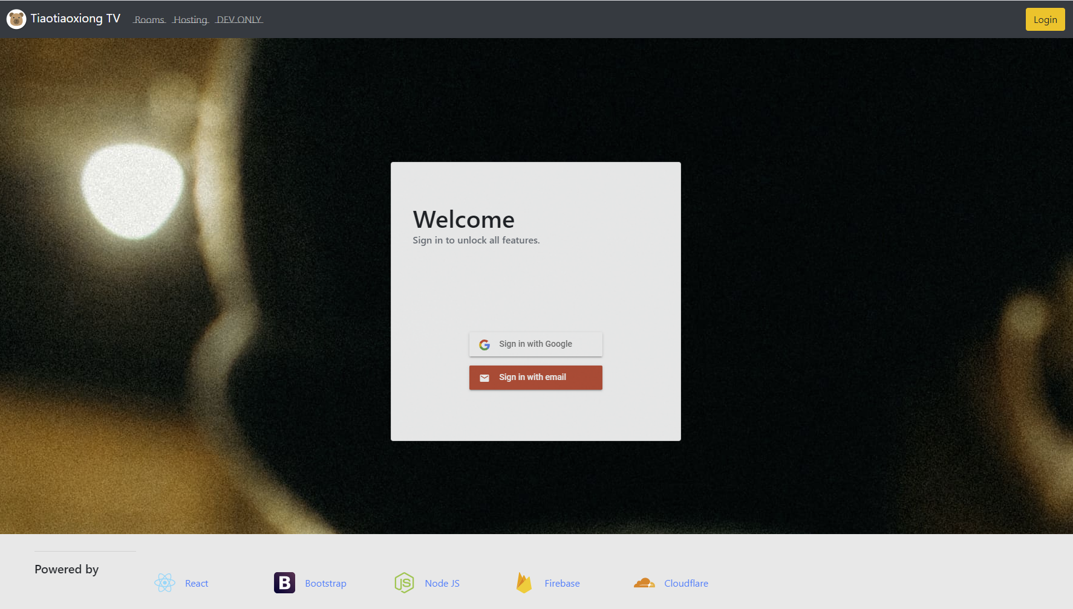
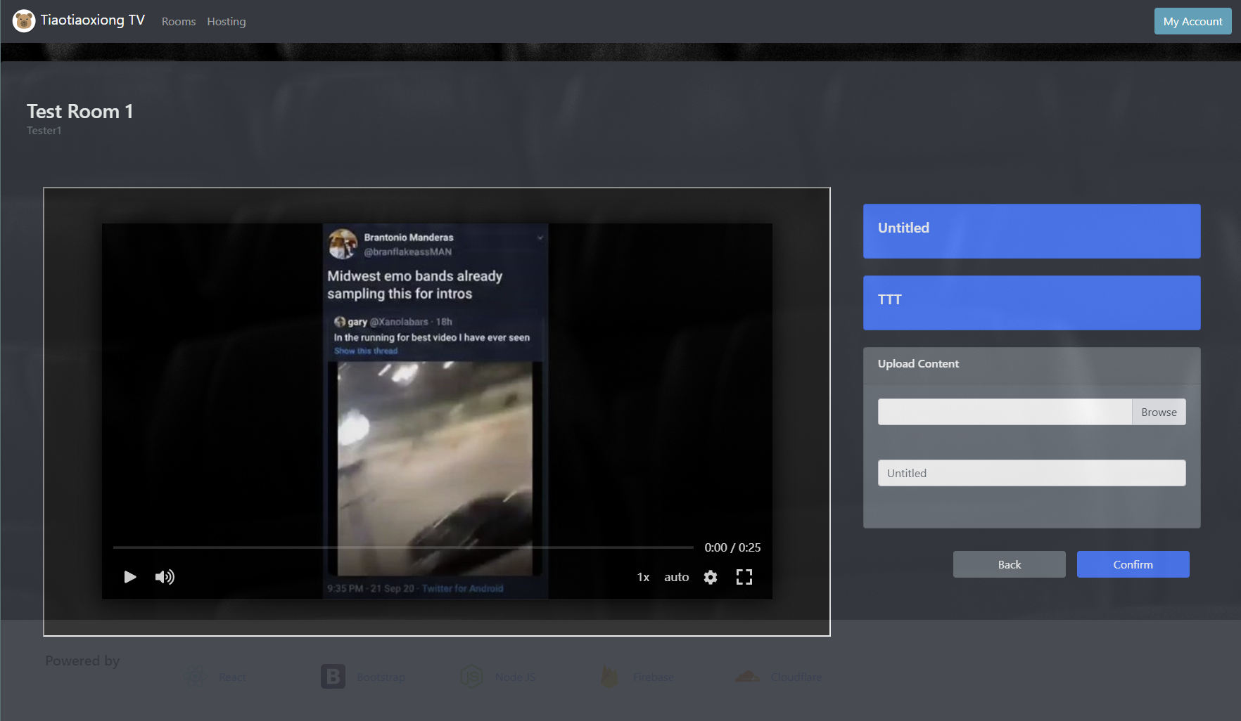
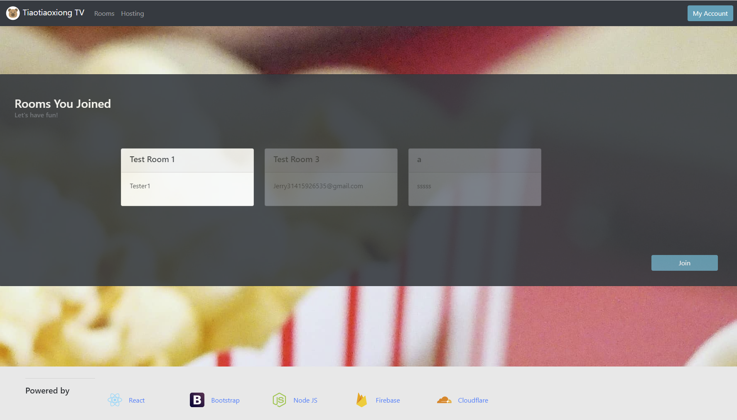

Slide 21
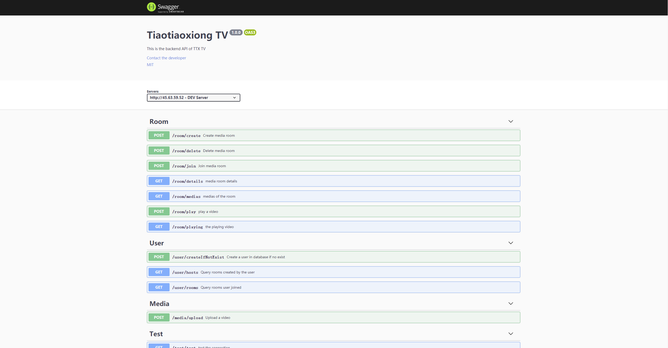
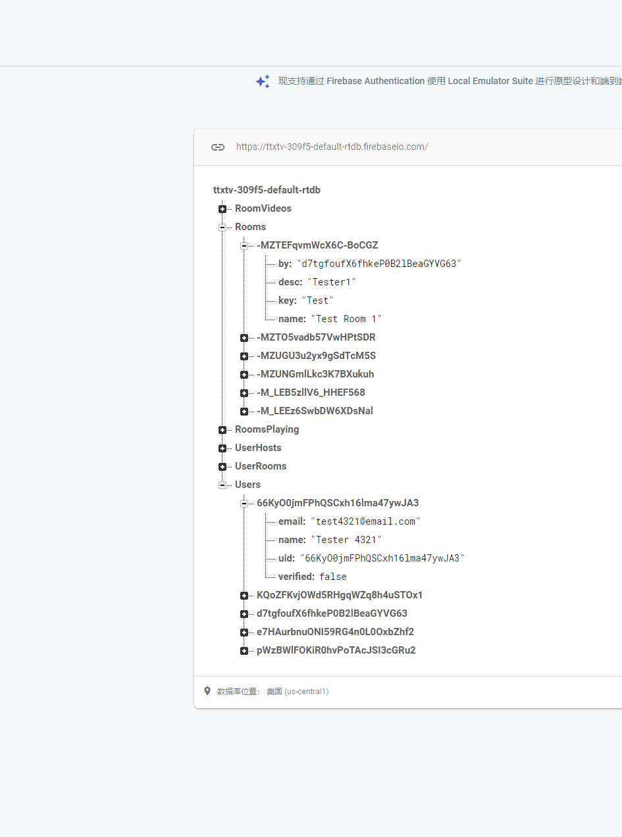
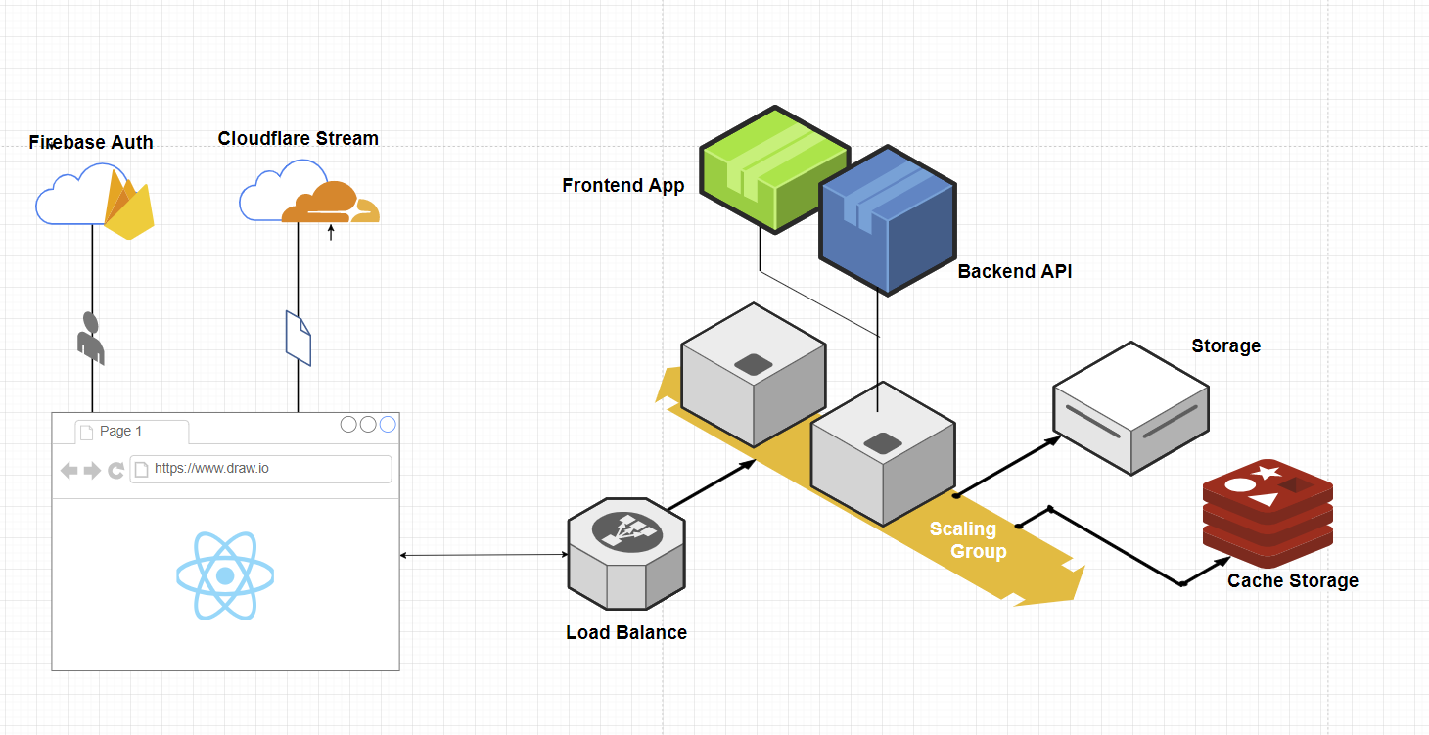

Slide 22
CODE DEMO

Slide 23
Resluts and Findings

Slide 24
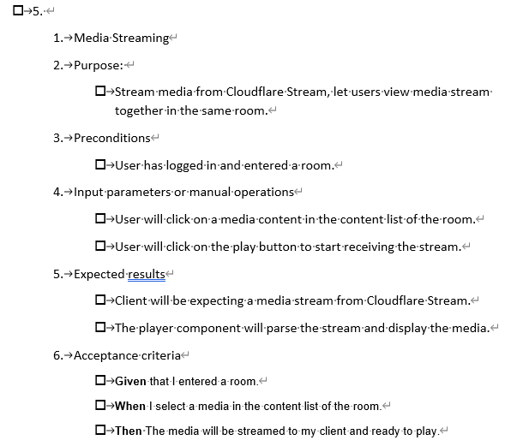
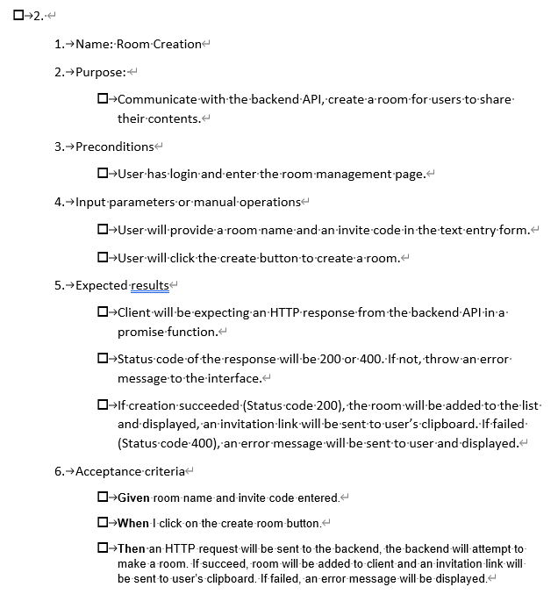
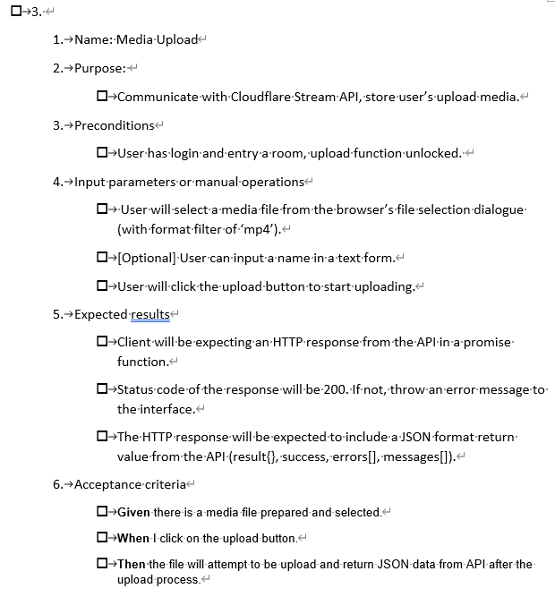
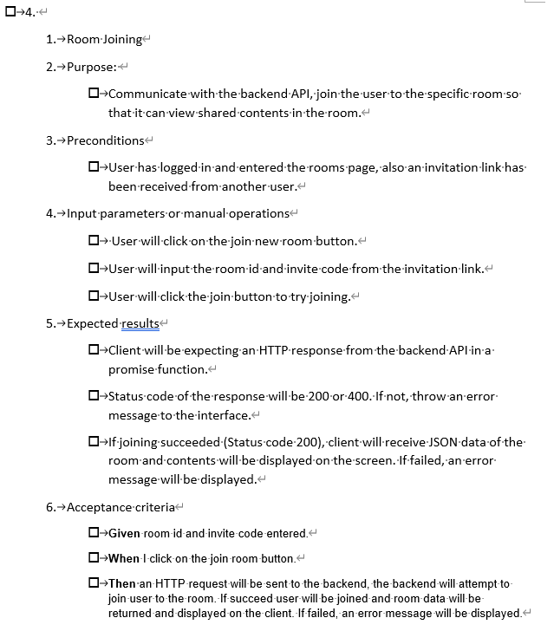
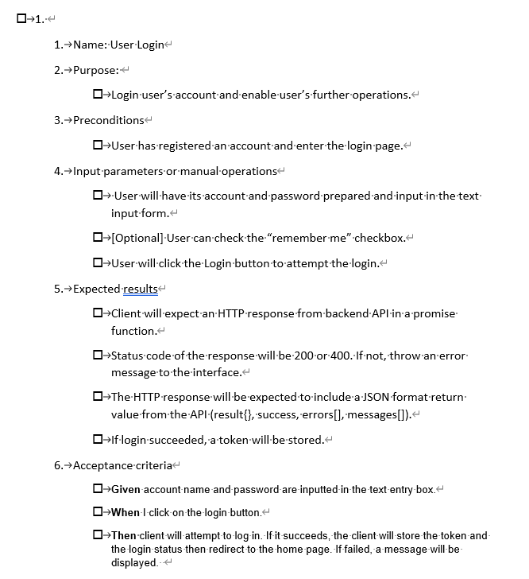

Slide 25
Free
Screening
Room
Immersive Experience
Custom Medias
MyCircle TV Zoom Netflix TTX TV

Slide 27
Thank you for listening

